Slide 1

Customer Retention-A Case study
Manoj.I.V
Date: 17th August, 2022
Internship by Flip robo Technologies

Slide 2
Problem Statement
E-retail factors for customer activation and retention: A case study from Indian e-commerce customers
Customer satisfaction has emerged as one of the most important factors that guarantee the success of online store; it has been posited as a key stimulant of purchase, repurchase intentions and customer loyalty. A comprehensive review of the literature, theories and models have been carried out to propose the models for customer activation and customer retention. Five major factors that contributed to the success of an e-commerce store have been identified as: service quality, system quality, information quality, trust and net benefit. The research furthermore investigated the factors that influence the online customers repeat purchase intention. The combination of both utilitarian value and hedonistic values are needed to affect the repeat purchase intention (loyalty) positively. The data is collected from the Indian online shoppers. Results indicate the e-retail success factors, which are very much critical for customer satisfaction.
Be careful: There are two sheets (one is detailed) and second is encoded in the excel file. You may use any of them by extracting in separate excel sheet. The number of column(s) is more than 47. Read the column header carefully. Note: Data Scientists have to apply their analytical skills to give findings and conclusions in detailed data analysis written in jupyter notebook. Only data analysis is required.
Need not to create machine learning models /but still if anybody comes with it that is welcome.

Slide 3
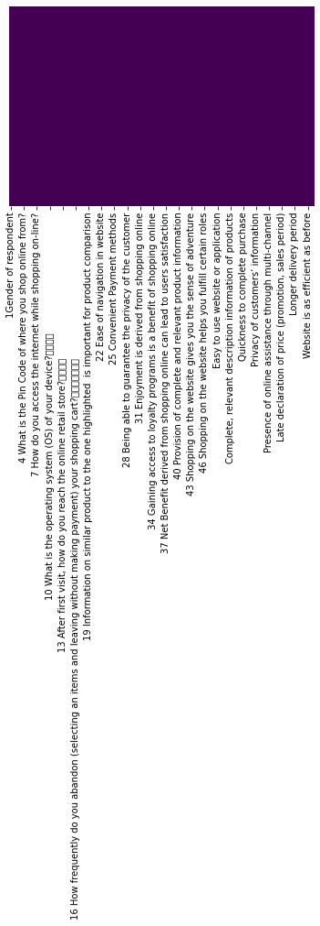
Null Data Set and Types of data
Number of variables | 71
Number of observations | 269
Missing cells | 0
Missing cells (%) | 0.0%
Duplicate rows | 60
Duplicate rows (%) | 22.3%
Total size in memory | 149.3 KiB
Average record size in memory | 568.5 B
Categorical | 70
Numeric | 1

Slide 4
Univalent Analysis

Slide 5
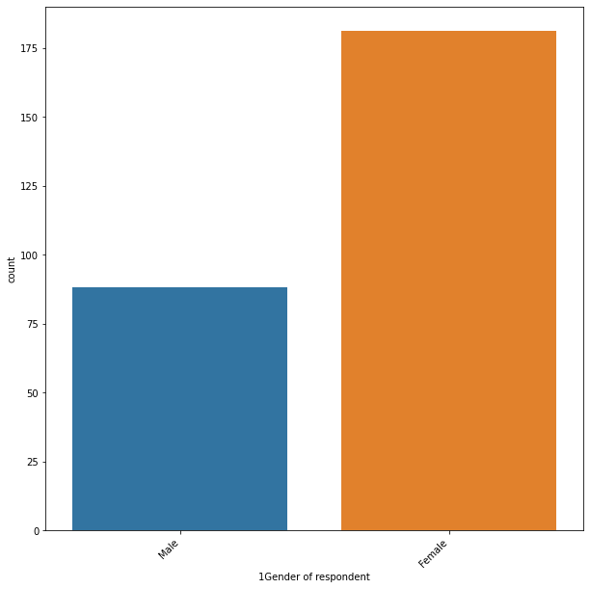
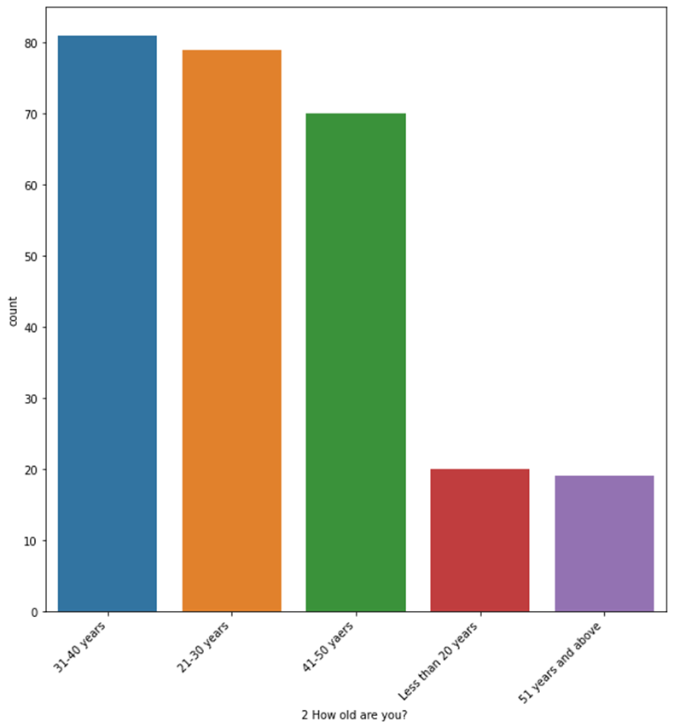
The female population of the dataset is more than male population
The 31-40 yrs. and 21-30 yrs. of the dataset does more shopping than other age limit people

Slide 6
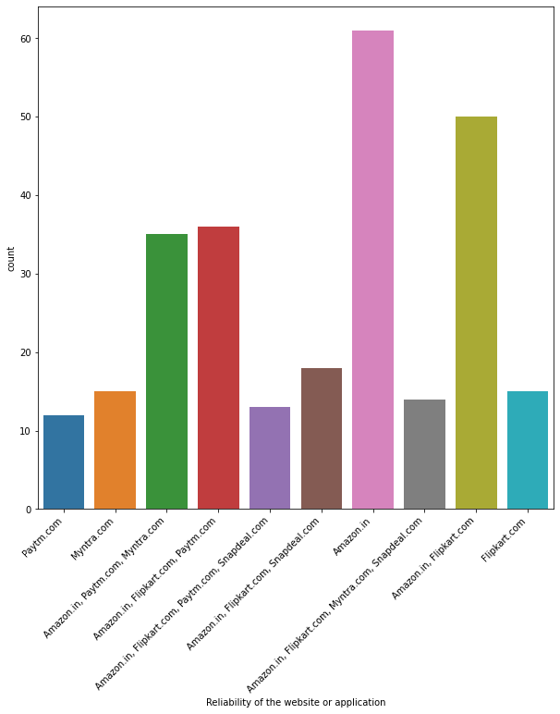
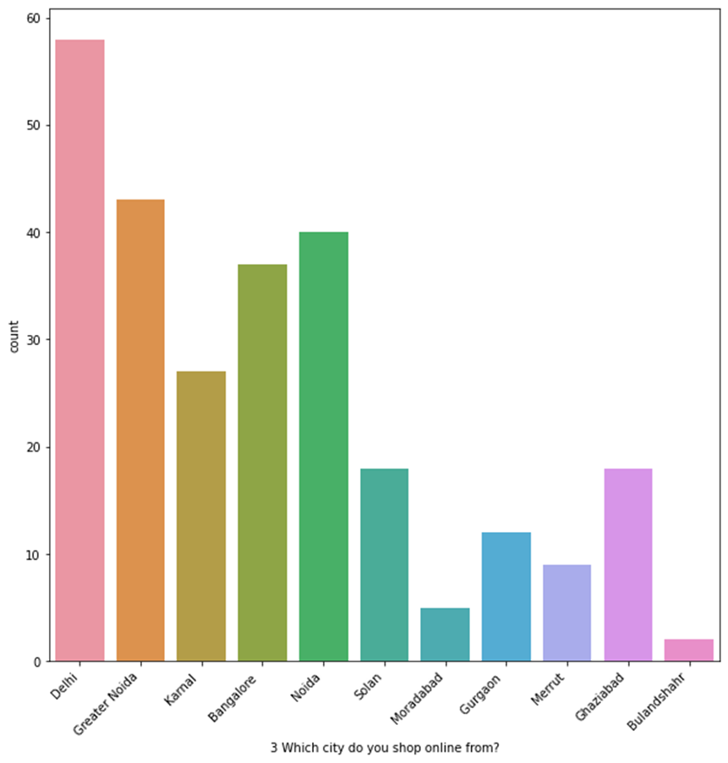
The states like Delhi has the most shopping count followed by Greater Noida, Noida and Bangalore
The Amazon.in has the most shopping count

Slide 7
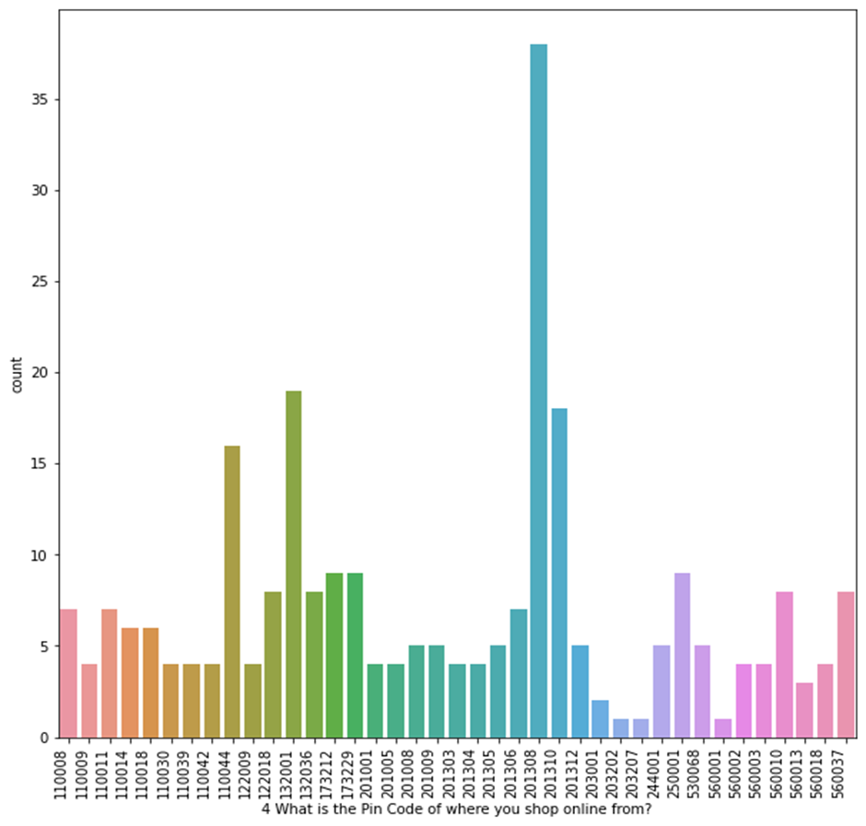
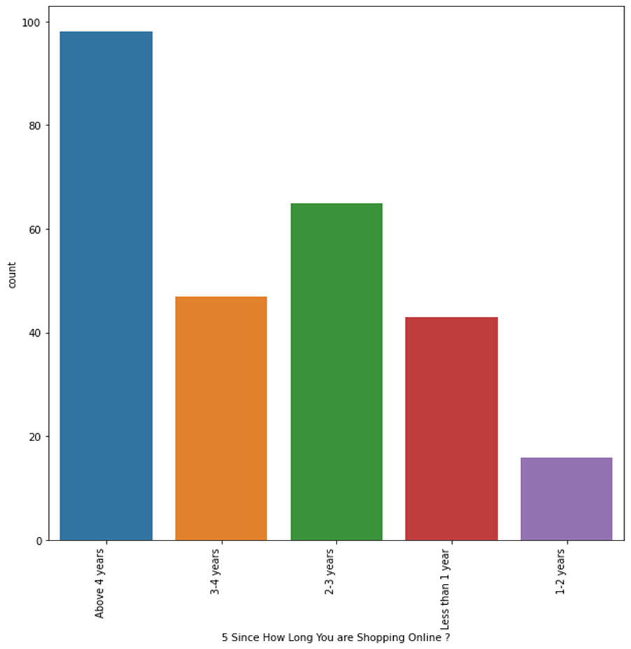
The state having pin code 201308 has the most shopping count followed by 132001, 201310 and 110044
People having 4yrs counted highest followed by 2-3yrs, 3-4yrs

Slide 8
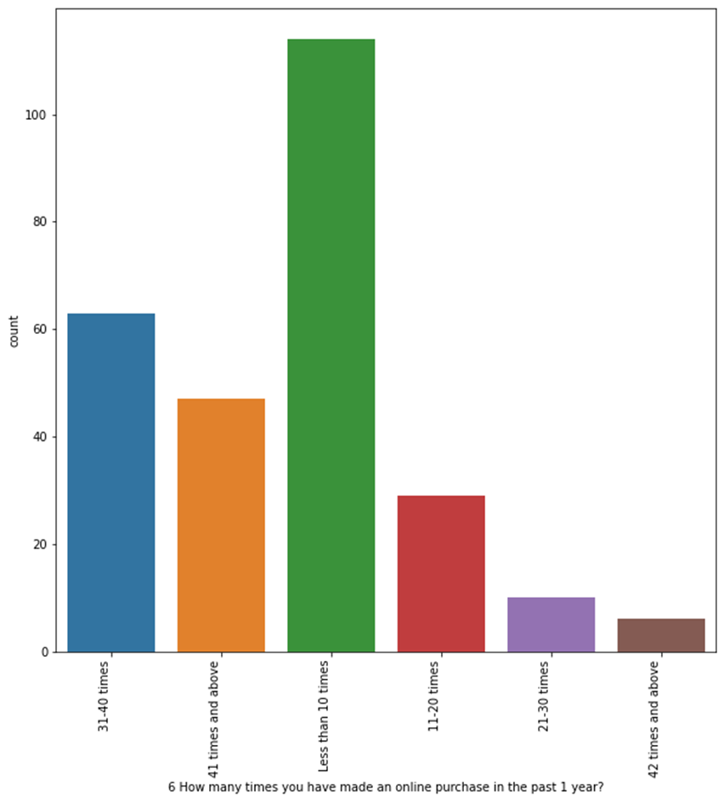
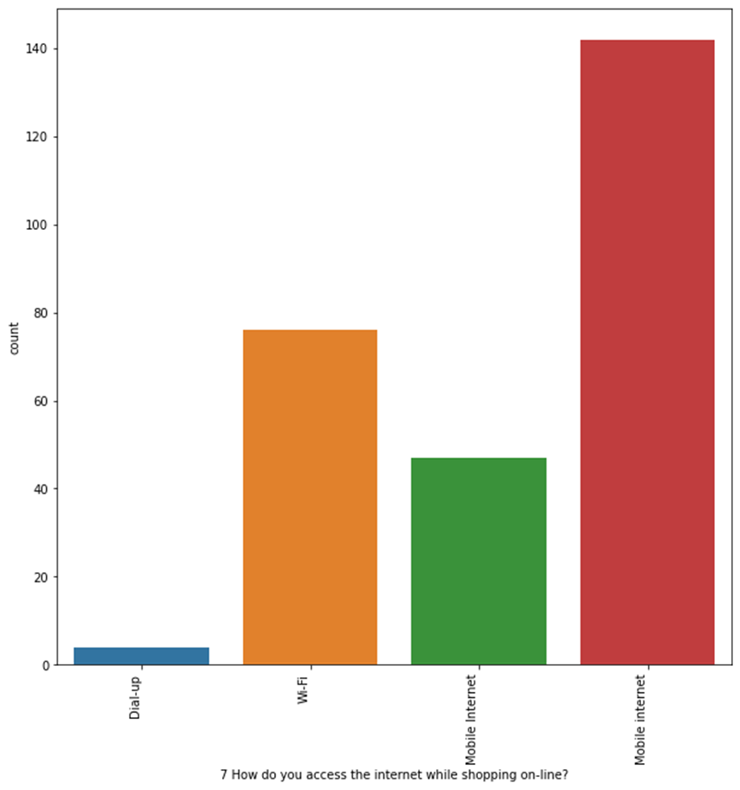
The people with less than 10 times more followed by 31-40 times.
The people order with mobile internet most of the time followed by Wi-fi.

Slide 9
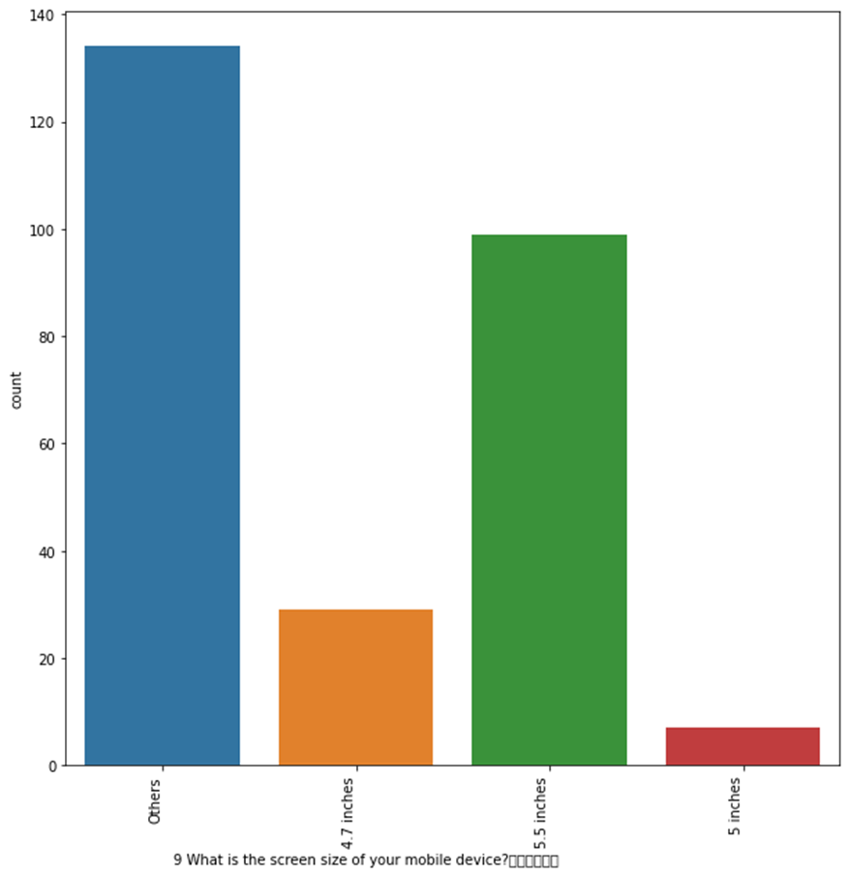
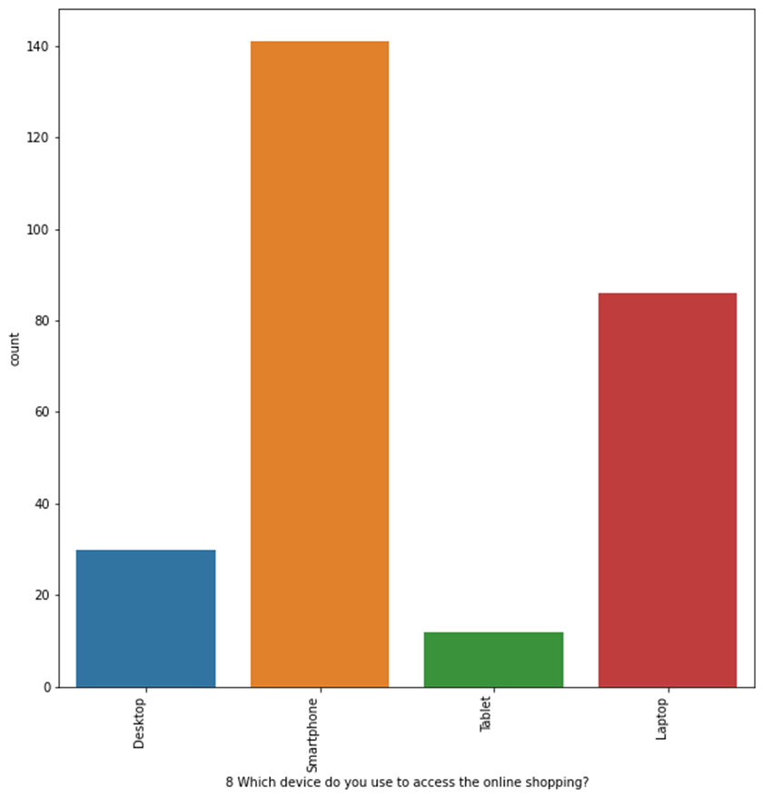
The smart phone device is used by the people followed by Laptop, Desktop.
The device with higher screen is used by the people followed by 5.4, 4.7.

Slide 10
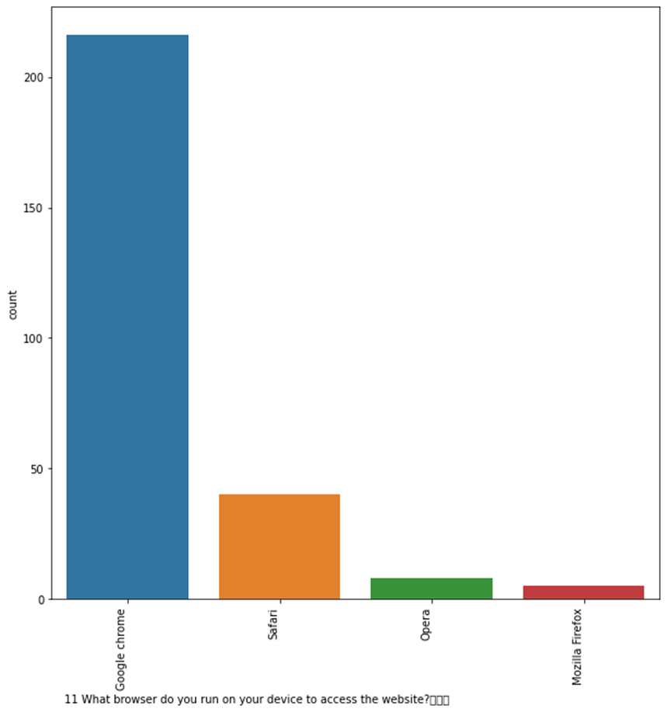
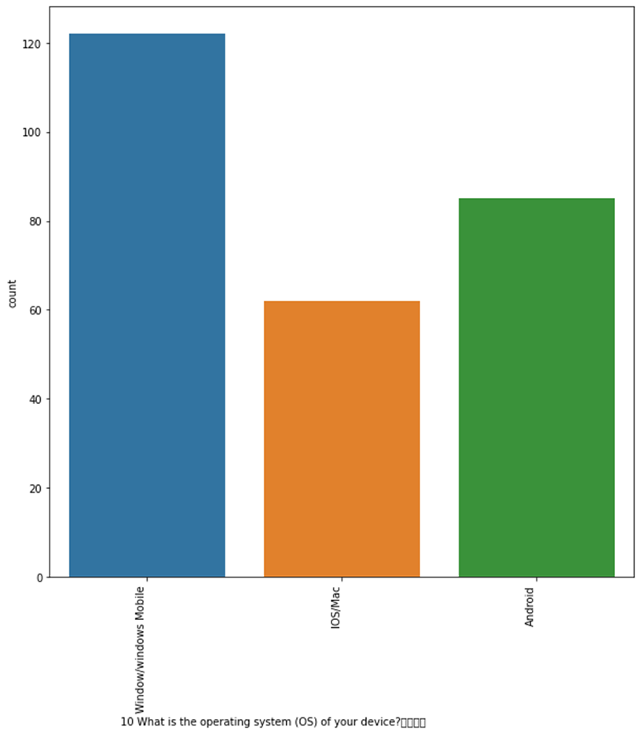
The smart phone device with the operating system windows mobile is used highest followed by the IOSMac and android.
The google chrome is the highest used browser followed by safari and opera.

Slide 11
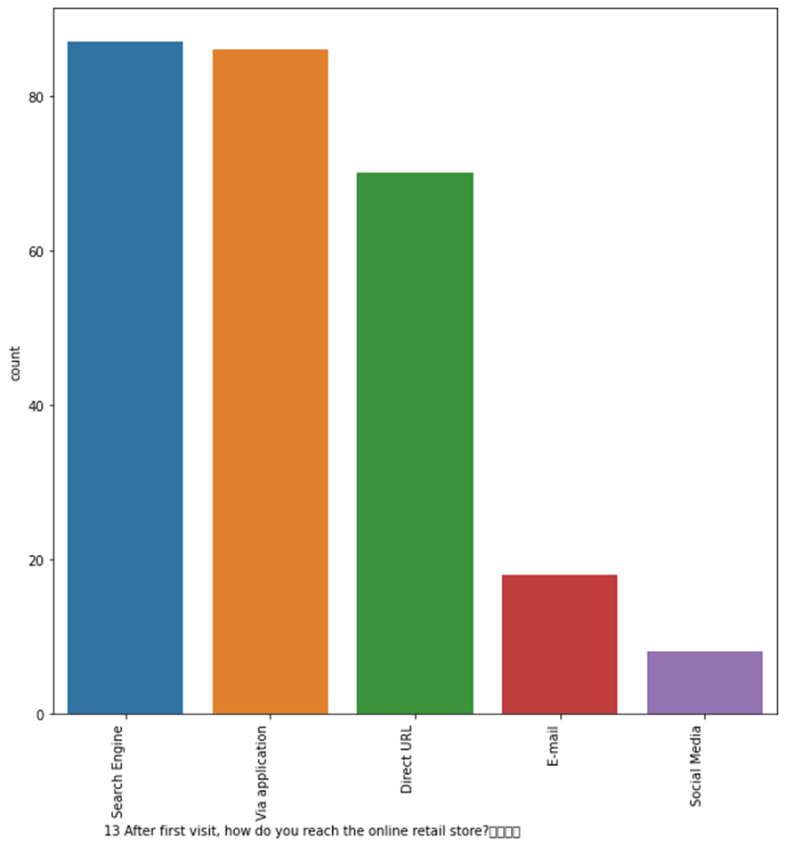
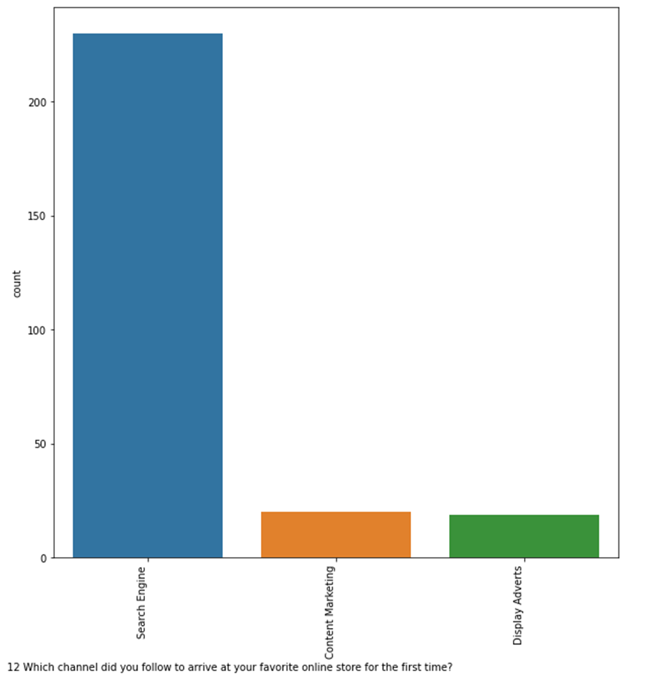
The search Engine is most used for the online shopping.
The search Engine is most used and reached for the online shopping.

Slide 12
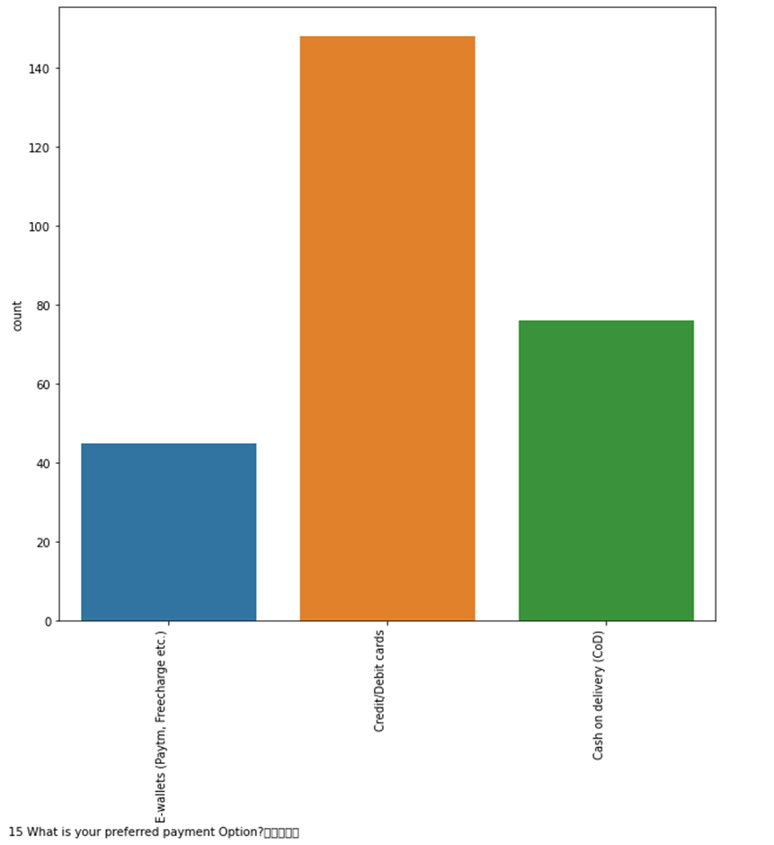
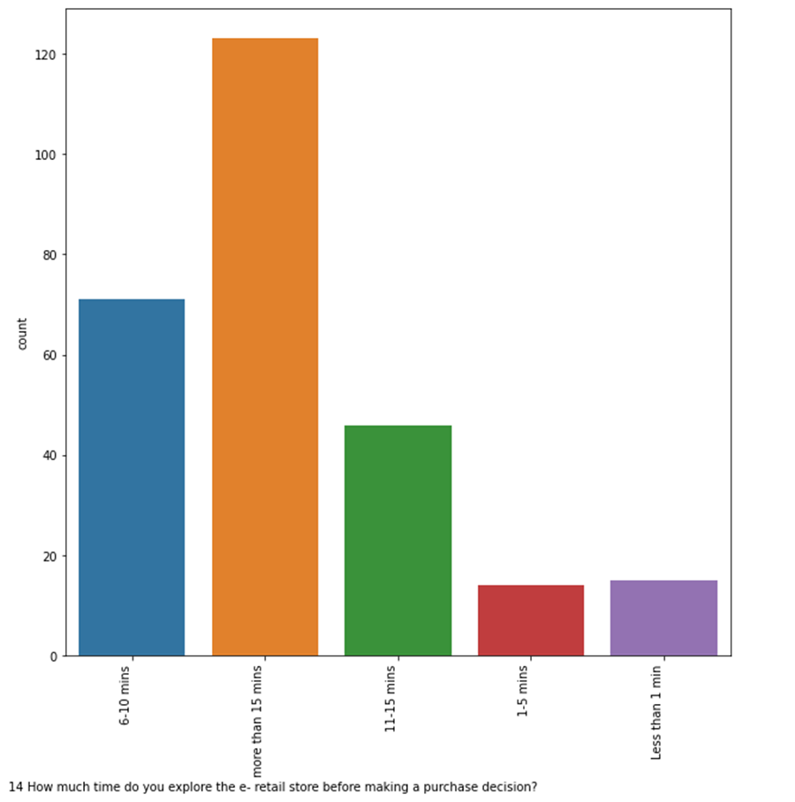
People search more than 15 times before buying the product
Most people use credit/Debit cards for purchases

Slide 13
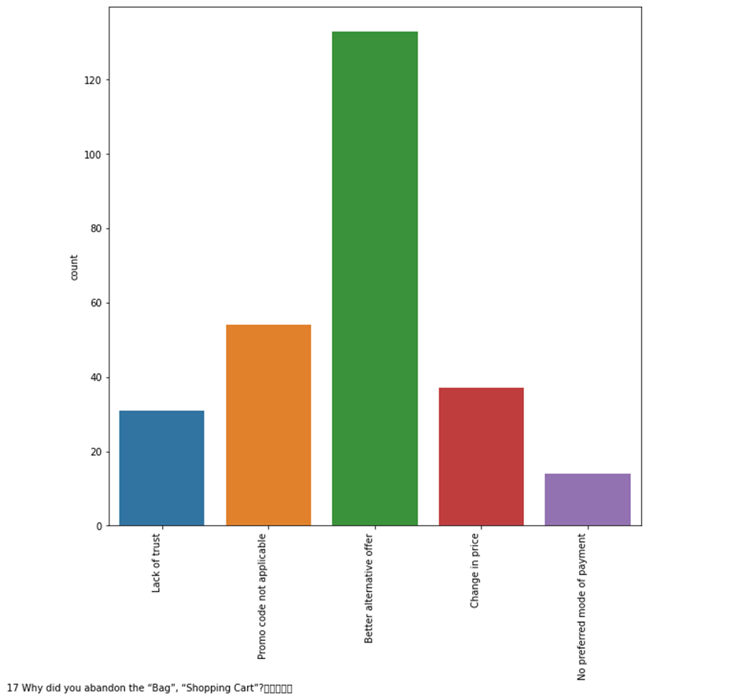
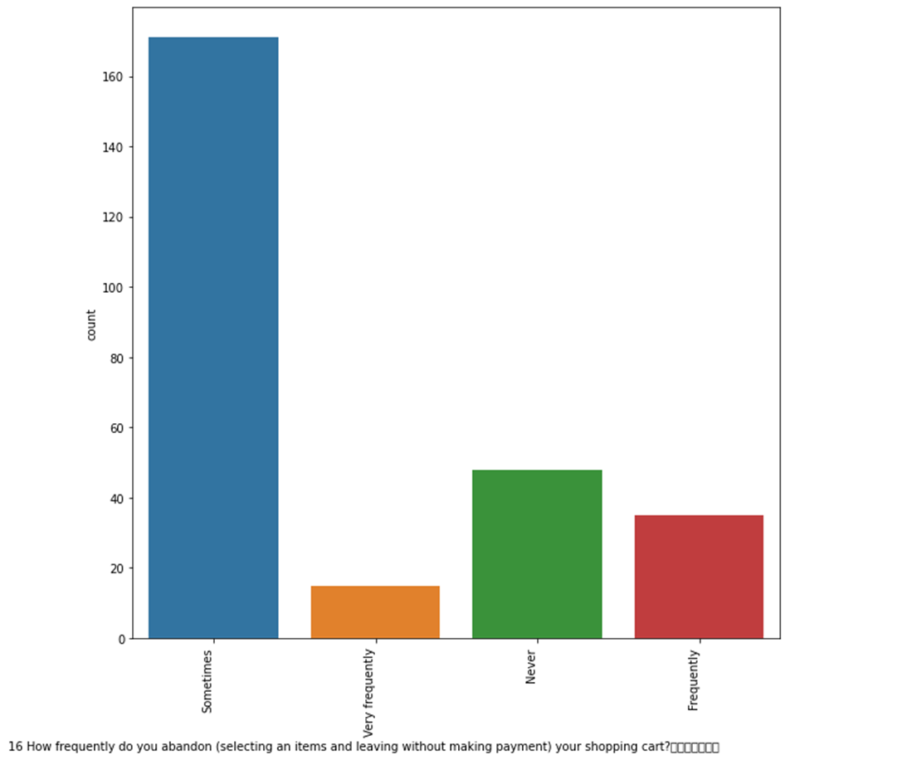
People buy the product sometimes which is picked in the cart
Most of the people abandon the cart because of better offers

Slide 14
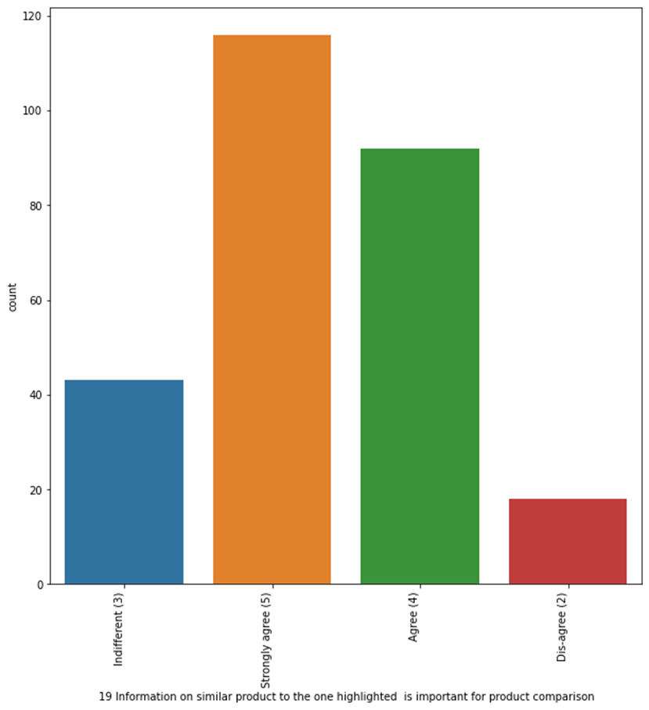
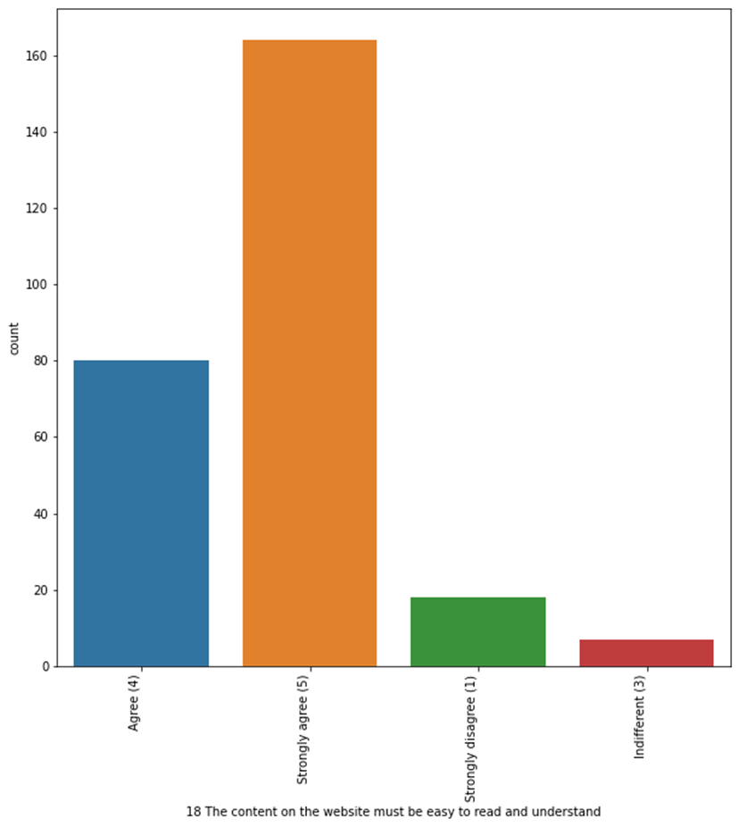
People buy the product sometimes which is picked in the cart
Most people want alternative product with same specification so they want to compare with product of same specification.

Slide 15
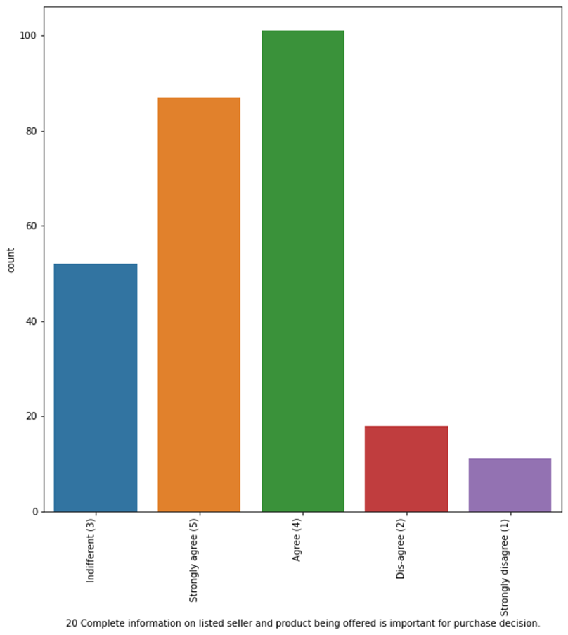
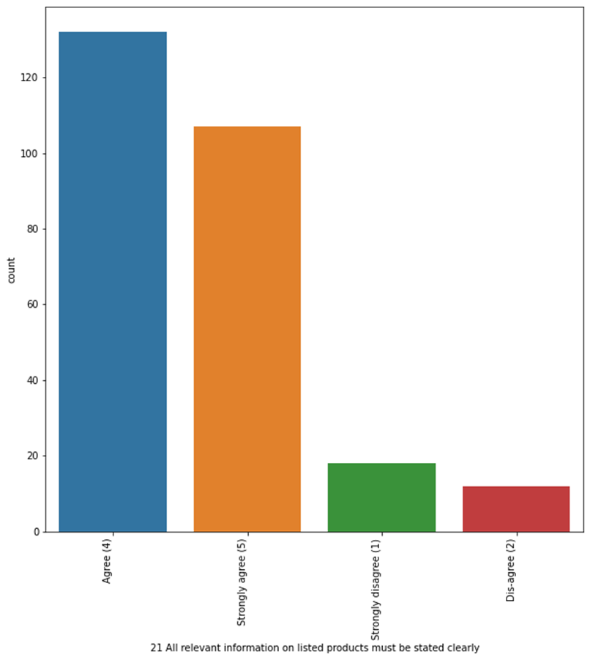
Most of the people agree for shopping online gives all the information on the products

Slide 16
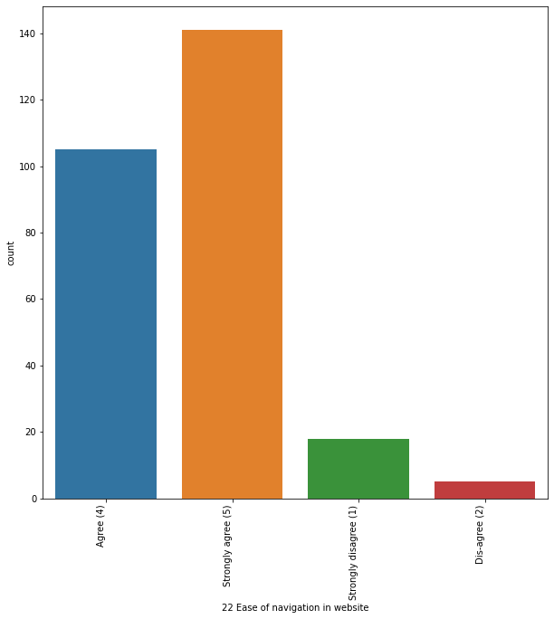
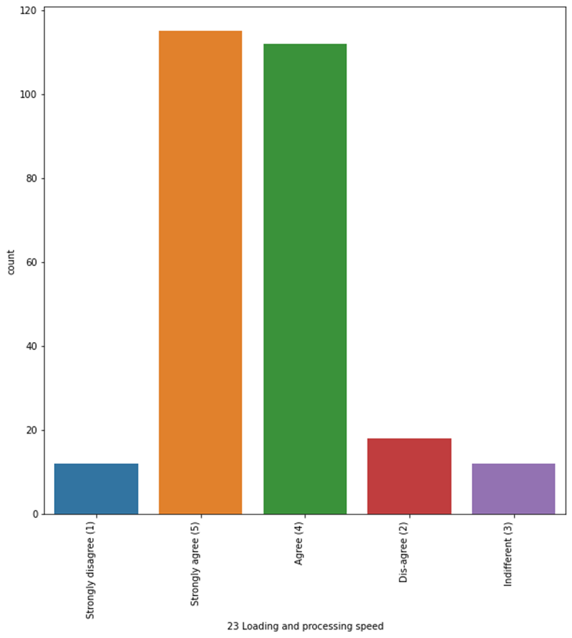
Most of the people agree for shopping online gives ease of navigation and loading speed

Slide 17
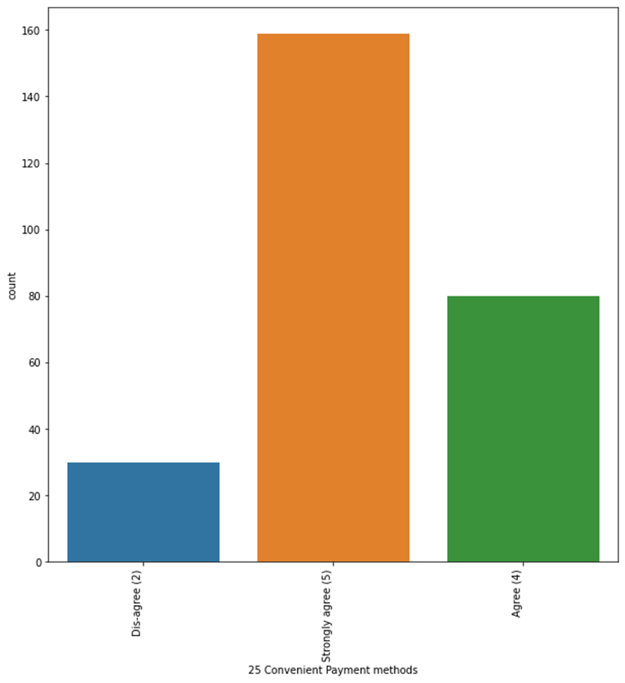
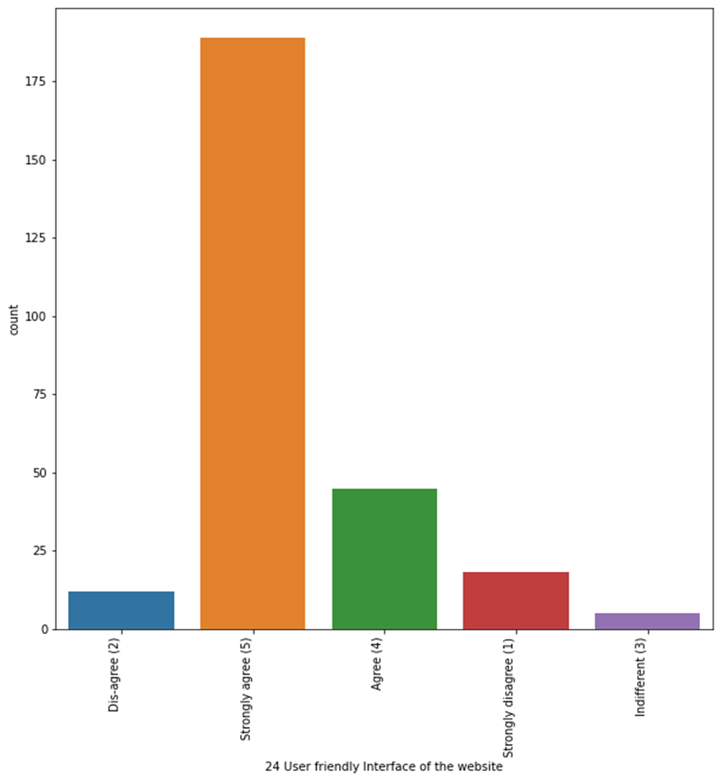
Most of the people agree for shopping online gives user friendly website and convenient payment methods

Slide 18
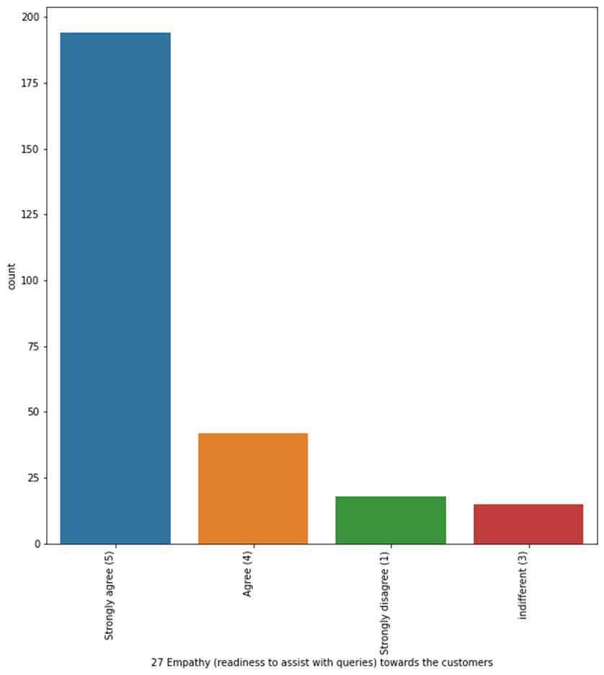
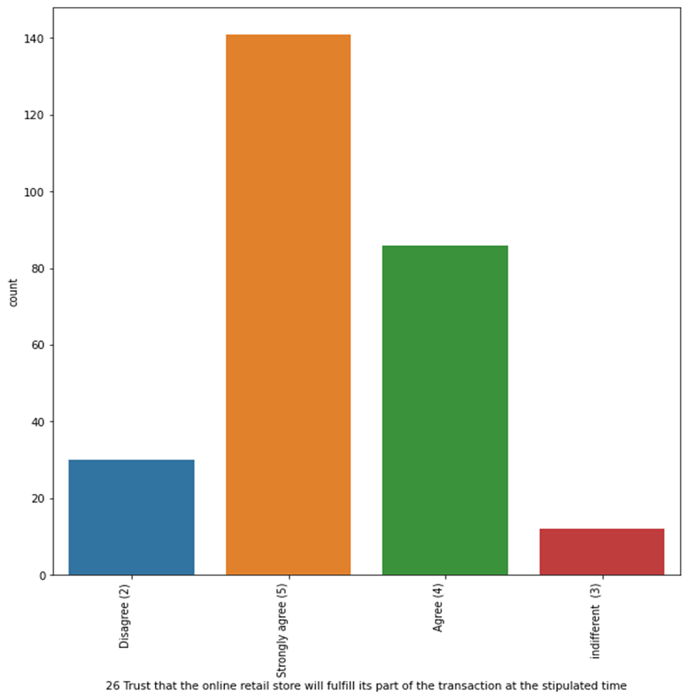
Most of the people agree for shopping online gives trust and empathy towards customers

Slide 19
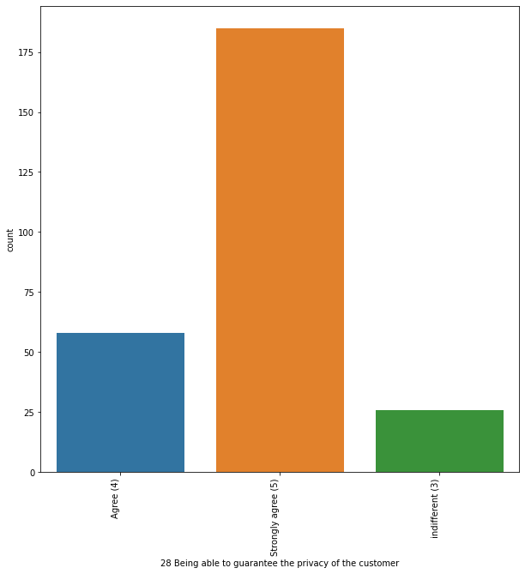
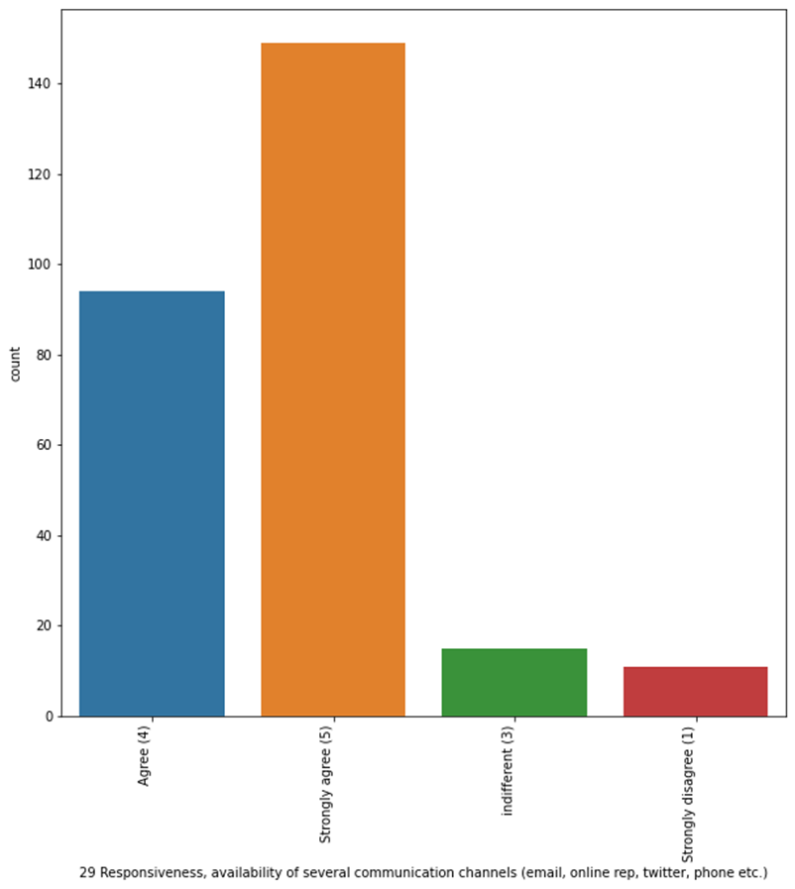
Most of the people agree for shopping online gives trust and empathy towards customers

Slide 20
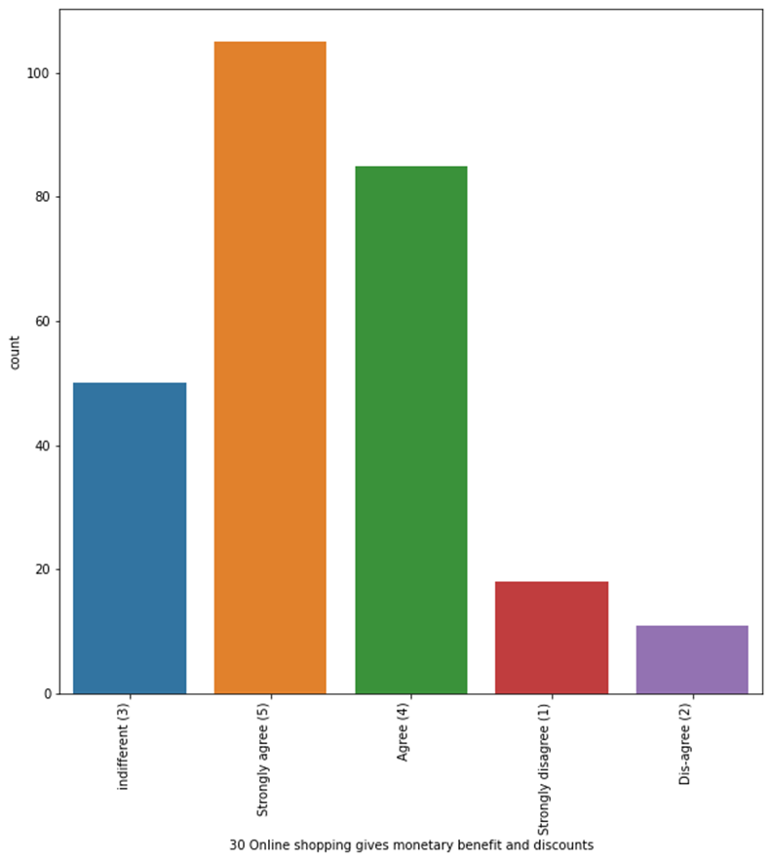
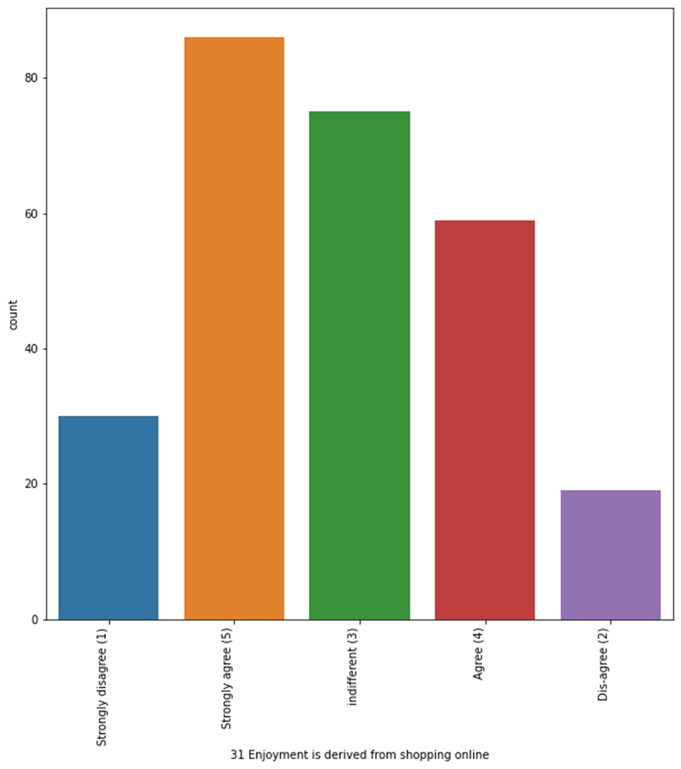
Most of the people agree for shopping online gives enjoyment and monetary benefits to customers

Slide 21
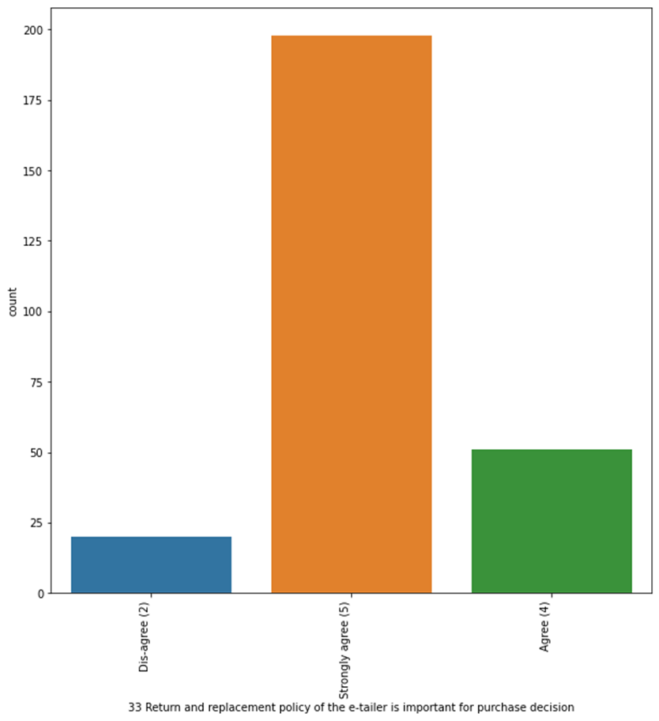
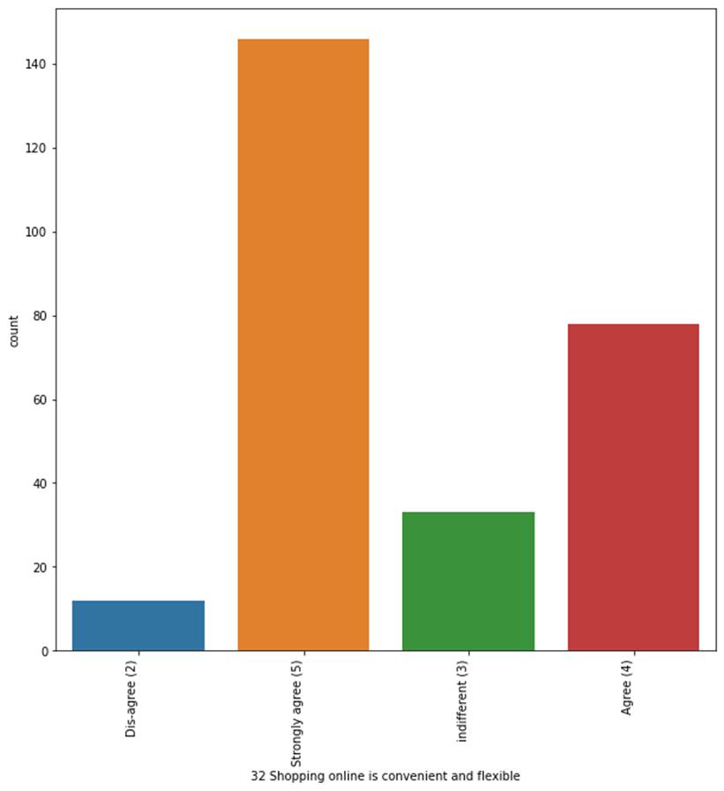
Most of the people agree for shopping online ease in exchange and flexible

Slide 22
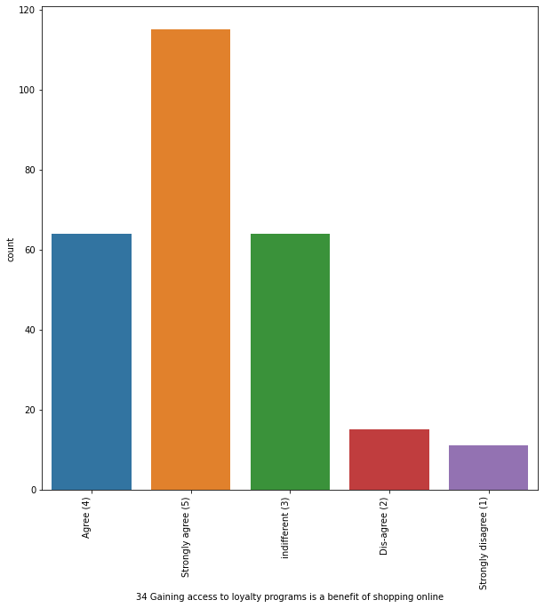
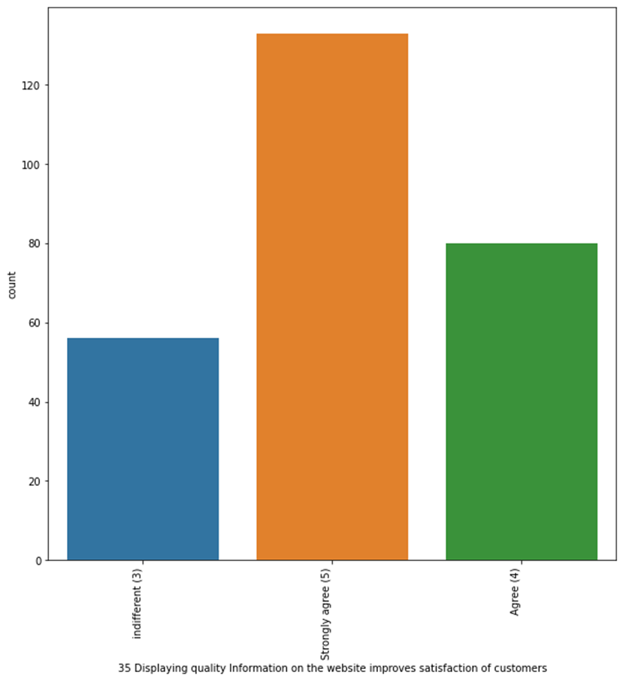
Most of the people agree for shopping satisfaction of the customers

Slide 23
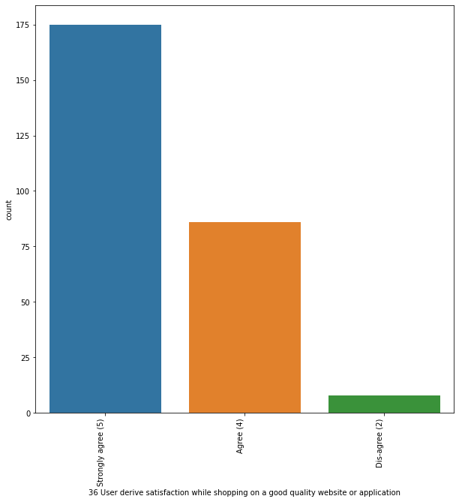
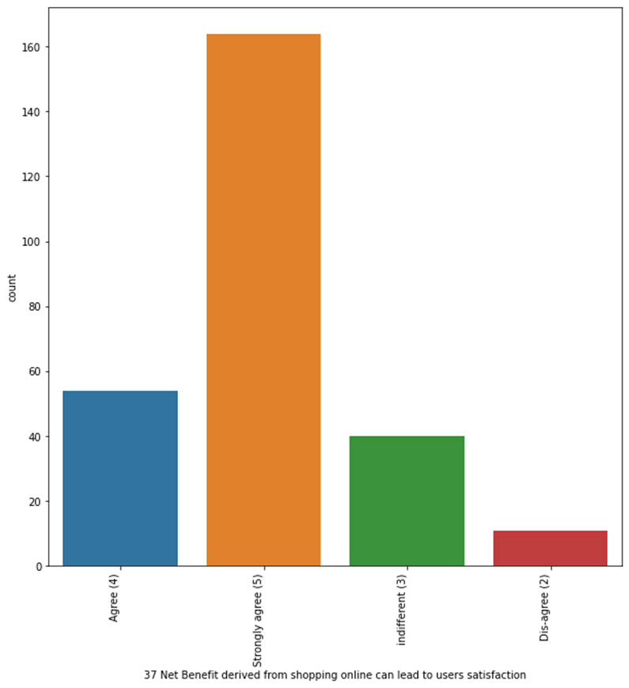
Most of the people agree for shopping online gives satisfaction and good quality website

Slide 24
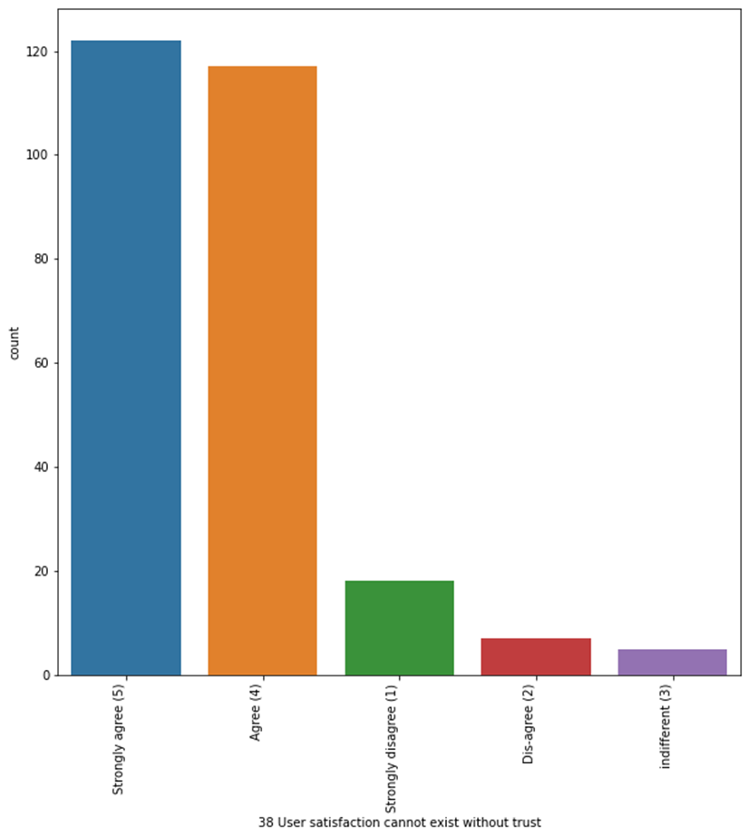
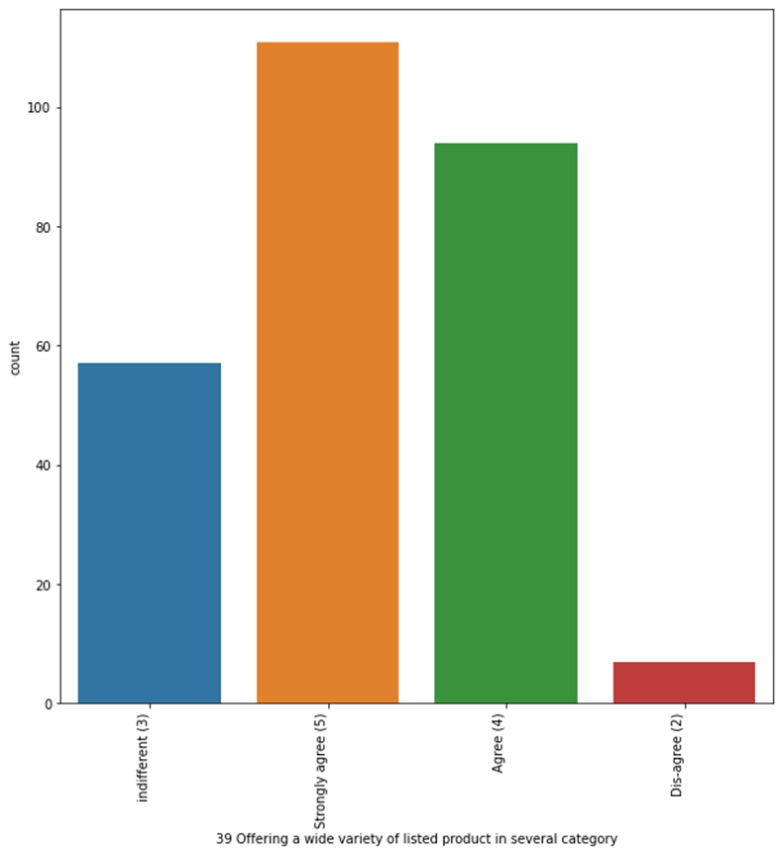
Most of the people agree for shopping online gives wide variety of list and induces trust

Slide 25
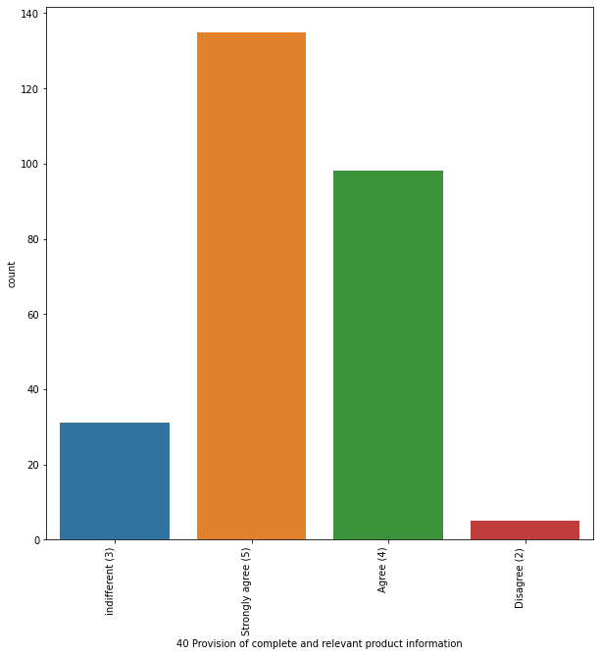
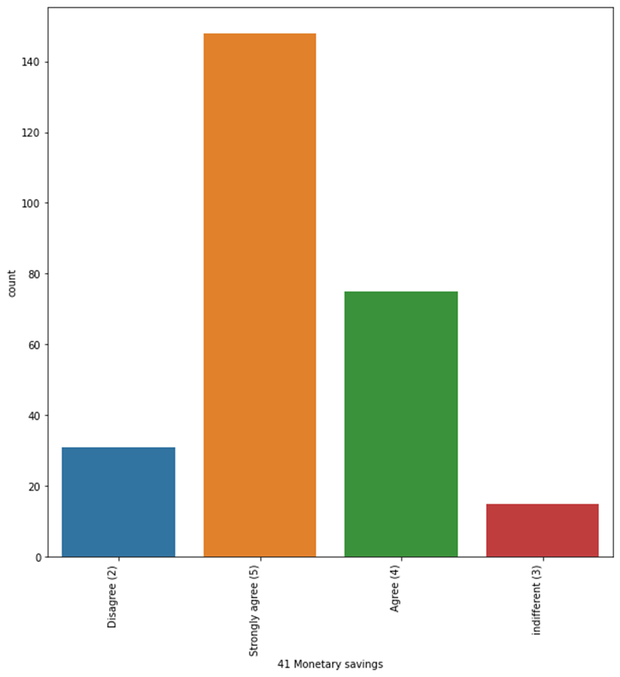
Most of the people agree for shopping online as it satisfies all the needs

Slide 26
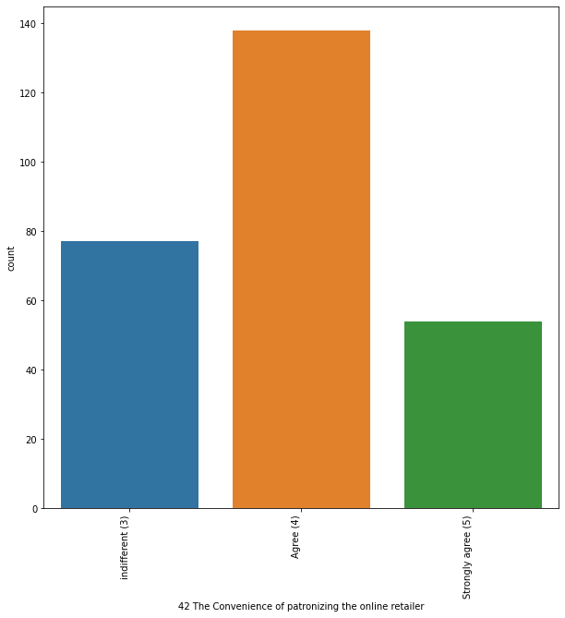
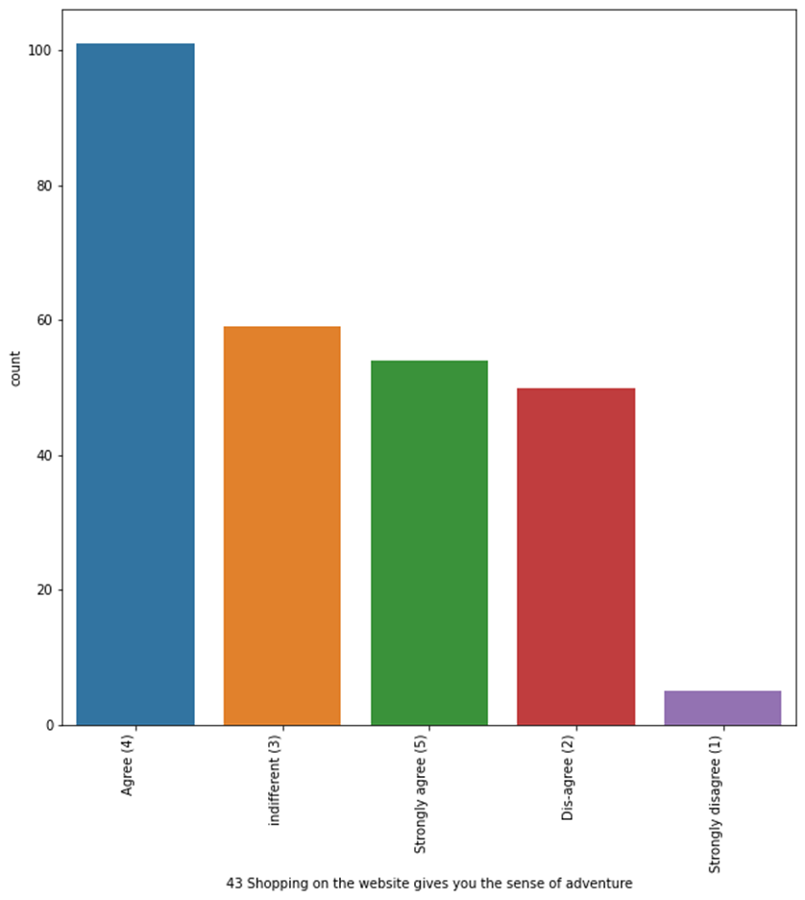
Most of the people agree for shopping online as it satisfies the sense of adventures

Slide 27
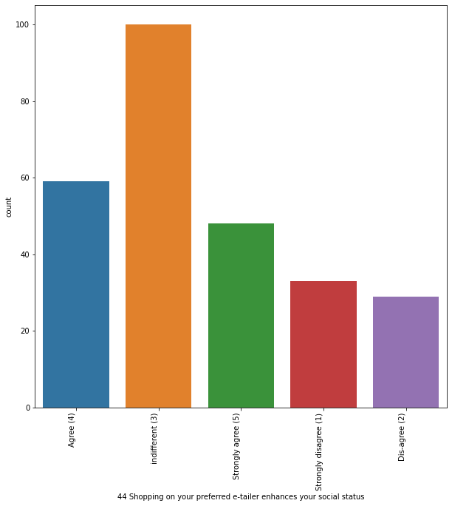
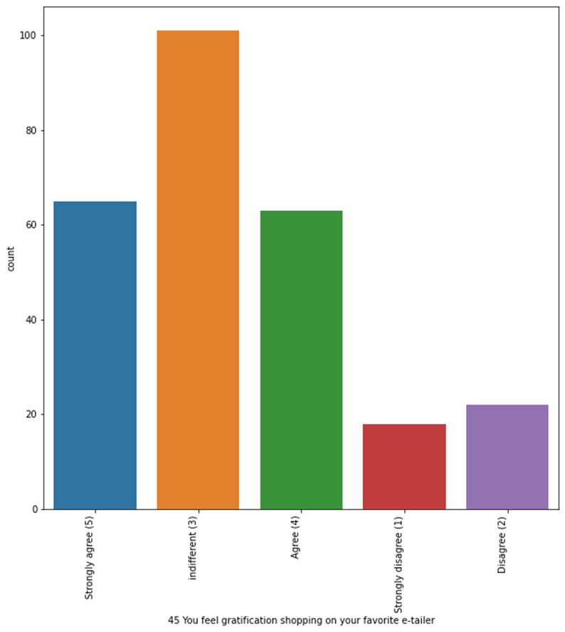
Most of the people agree for shopping online as it satisfies the human requirements

Slide 28
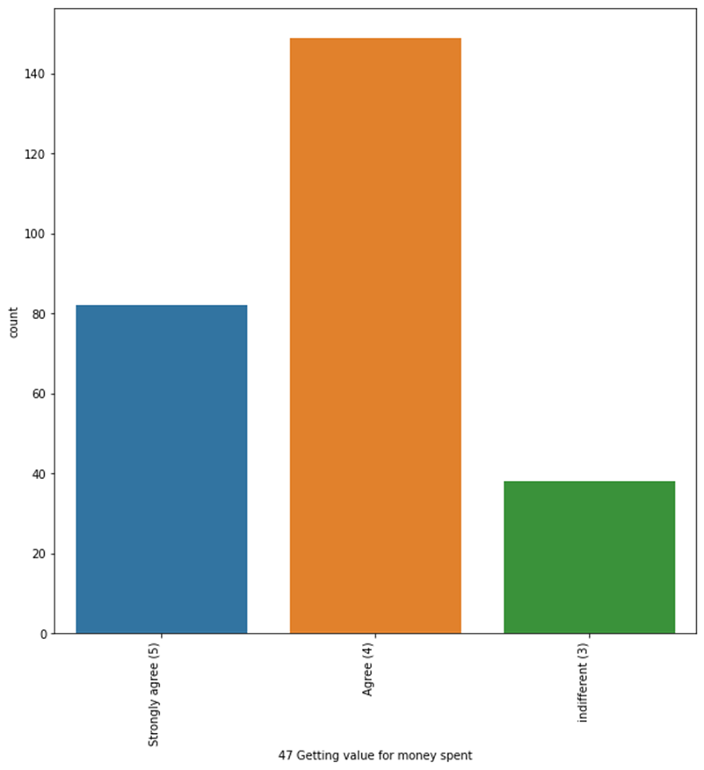
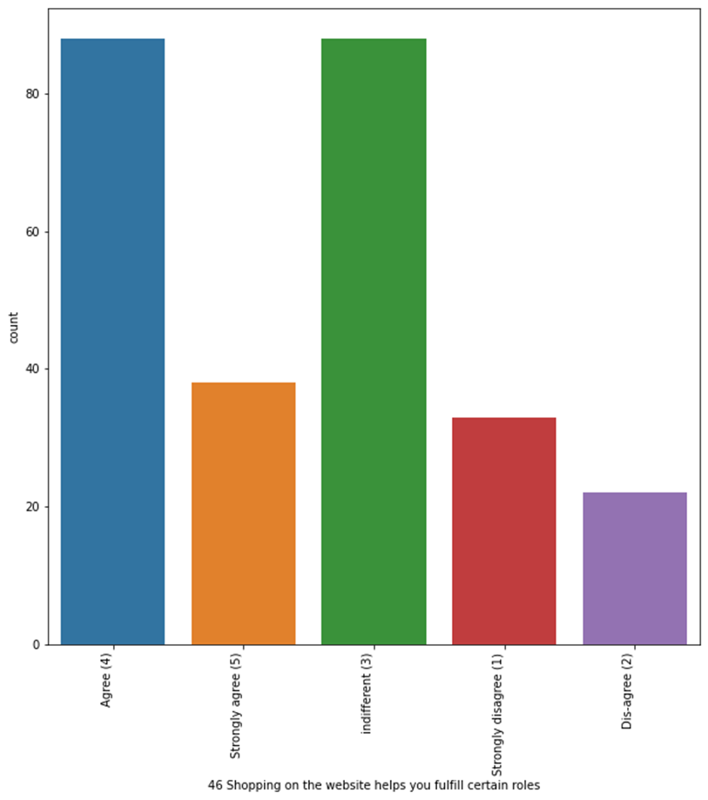
Most of the people agree for shopping online as it is value and helps in certain roles

Slide 29
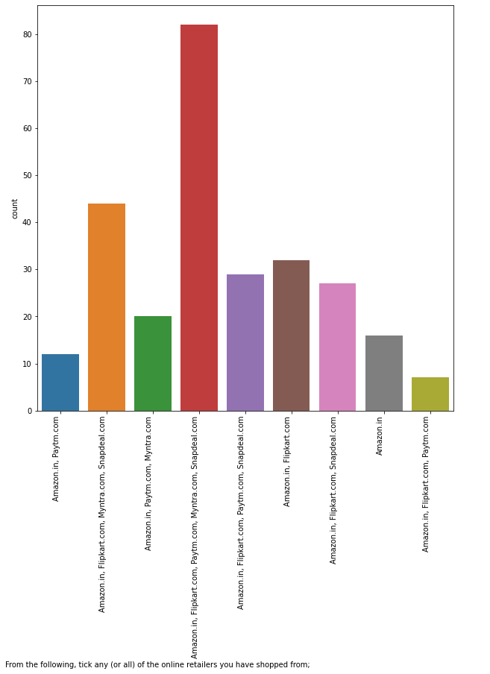

Amazon, flipkart, snapdeal and mytra easy to use applications among all the ecommerce software's

Slide 30


Amazon, flipkart are displaying variety of product and appealing page layout among all the ecommerce software's

Slide 31


Amazon, flipkart and payth are displaying product information and fast loading speed among all the ecommerce software's

Slide 32


Amazon and flipkart are reliable and quickness to complete the purchase among all the ecommerce software's

Slide 33


Amazon and flipkart are available for several payment options and quick delivery among all the ecommerce software's

Slide 34


Amazon and flipkart are most trustworthy because of privacy of customer information and financial information among all the ecommerce software's

Slide 35


Amazon and flipkart are most trustworthy and online assistance is available by multichannel among all the ecommerce software's

Slide 36


Amazon and flipkart have longer logging in time and loading time among all the ecommerce software's

Slide 37


Myntra and paytm has the most late declaration of price and longest loading time among all the ecommerce software's

Slide 38


Snapdeal.com has the most count for promotions and paytm is the longest delivery period among all the ecommerce software's

Slide 39


Amazon.in has the most count for change in website and disruption among all the ecommerce software's

Slide 40


Amazon.in is the most efficient and recommended website among all the ecommerce software's

Slide 41
Bivariate Analysis

Slide 42



Slide 43



Slide 44



Slide 45



Slide 46



Slide 47



Slide 48



Slide 49



Slide 50



Slide 51



Slide 52



Slide 53



Slide 54



Slide 55



Slide 56



Slide 57



Slide 58



Slide 59



Slide 60



Slide 61



Slide 62



Slide 63



Slide 64



Slide 65


Slide 66
Automatic report Generation
Pandas Profiling Report: http://localhost:8888/view/your_report.html
Dtale: http://vishal:40000/dtale/main/2

Slide 67
Conclusions
Amazon.in is the most efficient and recommended website among all the ecommerce software's
People prefer mobile internet for shopping.
Paytm and snapdeal.com is the longest delivery period among all the ecommerce software's
Amazon and flipkart have longer logging in time and loading time among all the ecommerce software's
Amazon and flipkart are available for several payment options and quick delivery among all the ecommerce software's

